Slide 1
PAST PERFECT CONTINuOUS
Rhea Roy Arindam Srivastava Ganni Likhit Nikhil Kumar Ragul RV Sivarama Chandra Yakub Mathew
Praneeth Roy Kunal Keshan Vaibhav Mohla.
Forms of Past Perfect Continuous Tense
Structure of Past Perfect Continuous Tense
Types of Past Perfect Continuous Tense
Difference between Past Perfect Continuous & Past Continuous

Slide 2
Forms of past perfect continuous tense
There are 3 form for past perfect continuous they are affermative, Negative and Interrogative
The words what, where, when, how, etc will be used before "had" in interrogative sentences.
Helping Verbs "had been" are used in sentence. 1st form of Verb +ing is used as main verb in sentence. "Since" or "for" is used before the "time reference" in sentence. If the reference is made to point of time such as 2002, 7 O'clock then "since" is used before the time in sentence. If the reference is made to period of time such as three hours, six years, four days, then "for" is used before the time in sentence.

Slide 3
Structure of past perfect continuous tense
Had + Been + [Verb] + ING (Present Participle)

Slide 4
What is present participle?
A present participle is a word that ends with "-ing,"
is formed from a verb
is used as an adjective or to form verb tense.

Slide 5
Example of Past perfect continuous tense
Had he been cooking any meal when she came to my home?
Had you been studying English all day?
Daniel had been watching TV for hours before he slept.
She had been walking since she got up.

Slide 6
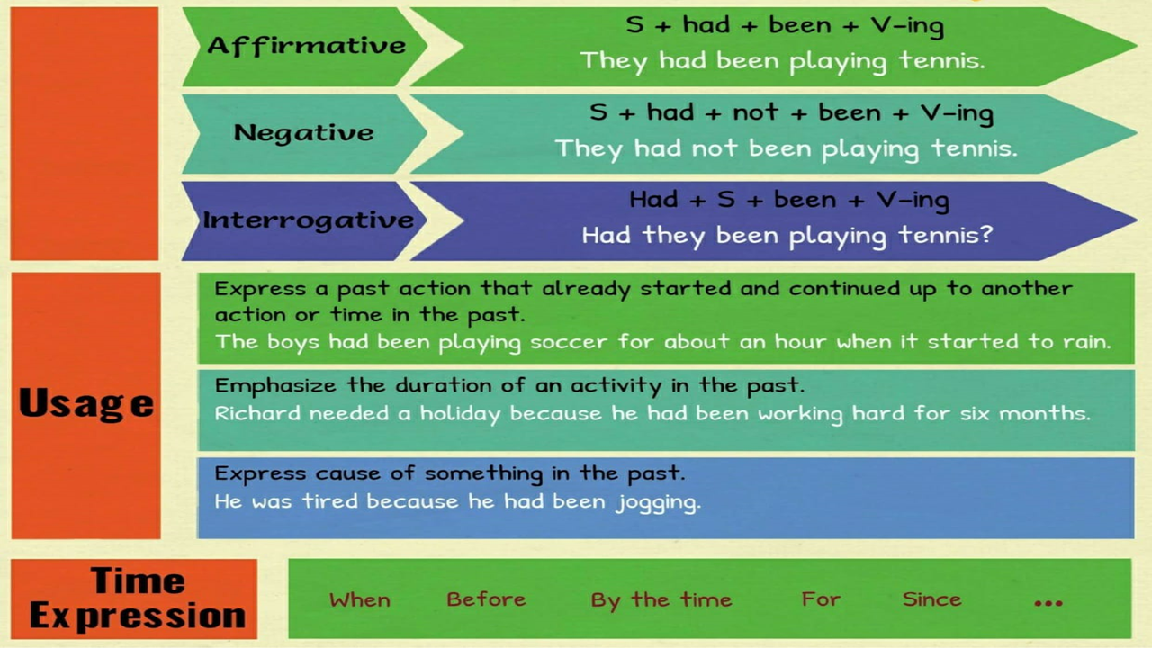
Types

Slide 7
Past perfect continuous vs past continuous

Slide 8
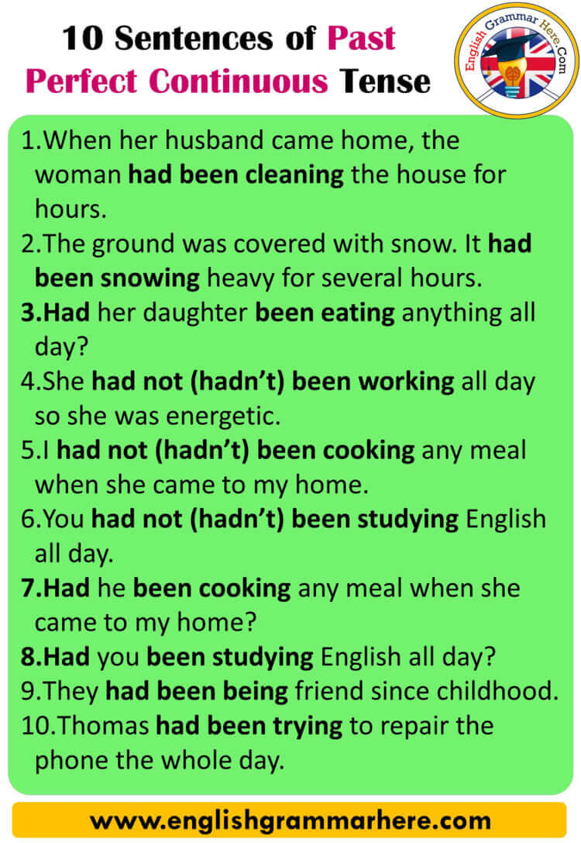
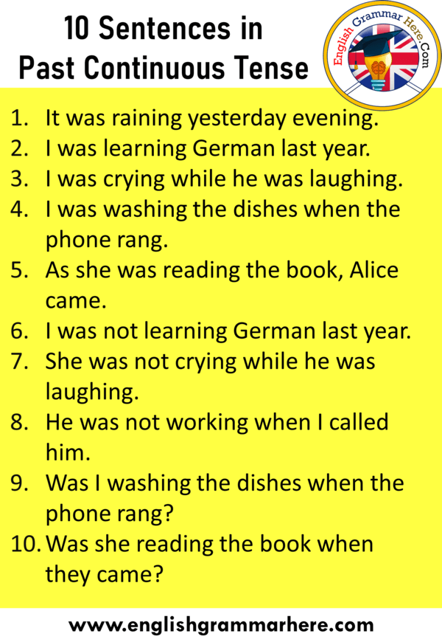

Slide 9
Thank you

